Slide 1
Using Graph with Windows 365
Dawn Wertz

Slide 2
Agenda
What is Graph
What is Permissions, Consent, and access token
Create Enterprise Application in Azure Active Directory
Automate Cloud PC Lifecycle in Graph

Slide 3
What is Graph
Microsoft Graph is the gateway to data and intelligence in Microsoft 365
Graph provides a unified programmability model that you can use to access Microsoft Cloud resources
Microsoft Graph is a RESTful web API that enables you to access Microsoft Cloud service resources.

Slide 4
Connection Requirements
Permissions
Consent
Bearer Token

Slide 5
Required Permissions
Review Graph API Documentation for what permissions are needed
List cloudPCs - Microsoft Graph beta | Microsoft Learn
License Permissions
User.ReadWrite.All, Directory.ReadWrite.All
Group Permissions
GroupMember.ReadWrite.All, Group.ReadWrite.All and Directory.ReadWrite.All
CloudPC Permissions
CloudPC.ReadWrite.All

Slide 6
Consent
Consent does not grant permissions it allows the use of existing permissions
User consent and admin consent
A user must consent to application specific permissions to act on their behalf
The admin must also consent for users to be allowed to consent to those permissions for the app
Delegated Permissions
Used with a signed-in user present, acts on user's behalf
Application Permissions
User sign-in presents is not necessary

Slide 7
Create Enterprise App
For automation use an Enterprise App
In production use key vault for secret
Create a new App Registration
Grant API Permissions and Consent
Find necessary permissions on Graph REST API Beta page https://learn.microsoft.com/en-us/graph/api/virtualendpoint-list-cloudpcs?view=graph-rest-beta&tabs=http
Consent for Organization in Enterprise App
Create a secrete in App Registration

Slide 8
Access Graph
Graph Explorer
https://developer.microsoft.com/en-us/graph/graph-explorer
Graph X-Ray
PowerShell
Windows 365 SDK – PowerShell Cmdlets
Web Rest Methods

Slide 9
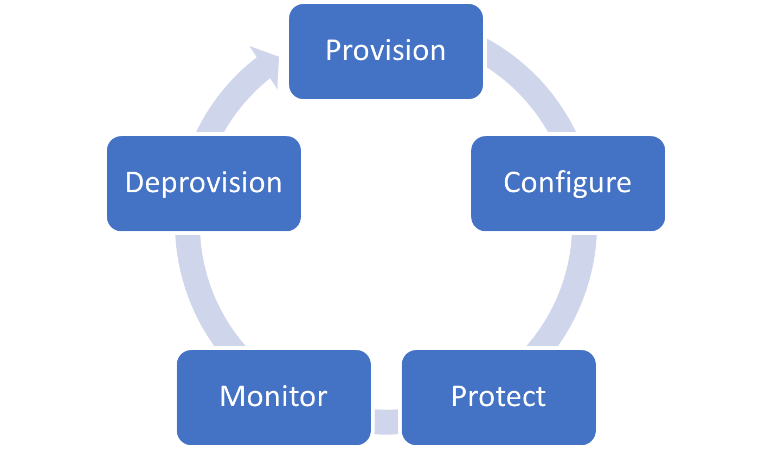
Cloud PC Lifecycle
Demonstrate
Provision
Monitor
Resize
Restart
Deprovision

Slide 10
Automation – Steps needed
Provisioning Policies
Provision a Cloud PC
Add License
Add group
Monitor Status
Restart Machine
Reprovision
Deprovision the Cloud PC
End Grace Period
End the Grace Period and delete the machine
Notes:
My demonstrations start with the Azure Network Connection already created and using the MS images, not custom images

Slide 11
Demos
Connect to Graph Script
Create provisioning policy
Provision a computer for AlexW@configgirl.onmicrosoft.com
Restart a computer Adelev@configgirl.onmicrosoft.com
Restore a snapshot Screen shot
Resize a computer LeeG@configgirl.onmicrosoft.com
Deprovision computer Adelev@configgirl.onmicrosoft.com
Send in grace email
End Grace period
Send email removed computer

